Slide 1

Machine Learning for Extraction and Classification of Adverse Drug Events from social Media
Name: Ahmed Hossam Ahmed Mohamed El Sabbagh
Supervised By: Prof. Kahled Nagaty
& Associate Prof. Nahla Barakat

Slide 2
Adverse Drug Reactions
Harmful or unpleasant reactions caused by the use of medicinal product.
Pharmacovigilance is the science of studying ADRs, their detection and prevention.
Notes:
This is meant to show why they should care, next slides explains how these labels are obtained through pharmacovigilance

Slide 3
Pharmacovigilance: Clinical Trials
Pharmacovigilance:
The science and activities relating to the detection, assessment, understanding and prevention of these effects.
Regulated by Various agencies:
FDA in USA
EMA in EU
WHO (World Health Organisation)
Everyone can participate:
Buyers
Users
Recommenders
Manufacturers (by obligation)
Online Reporting System:
FAERS
MedWatch
MERP

Slide 4
Motivation
ADRs are a major health hazard
In the US alone (2 million) of patients are hospitalized, because of ADRs.
That is more then 6% of all patients, 0.32% of whom (100 thousands) are fatalities.
Pharmacovigilance via social media has been recently introduced as a supplement to existing reporting methods.
Problem With Traditional reporting techniques:
Completely Voluntary (incomplete)
Under-reporting unknown ADRs
Over-reporting known ADRs
May not be wide reaching or easy enough to use
Advantages:
Expands the research population
Large free dataset available for all researchers
Social Media users are more active in asking and answering healthcare related questions, especially on specialized medical forums.

Slide 5
Project Objectives
This project aims to detect ADR from social media and medical forums focusing on two main aspects.
supervised learning: Using user information as features for algorithm to predict the possibility of an ADR.
Unsupervised: Find relations between drugs, ADRs and other concepts, using word embedding and association rule mining.

Slide 6
Related Work: Lexicon Based Techniques (Unsupervised)
Leaman et al. Tried to identify posts where there is an ADR mention, using a lexical analyzer, finding certain phrase structures and verbs that indicate side effects. F-Score = 73.9%.
A. Nikfarjam and G. H. Gonzalez Tried to use pattern matching with association rule between, POS tags following certain rules. F-Score = 67.96%.

Slide 7
Supervised Learning
A. Sarker and G. Graciela Tested several classifiers (SVM, Naïve Bayes, and Decision tree) with a corpus from multi-source dataset corpus. Using several lexical features to identify ADR mentions. Best F-Score = 0.812.
Y. Zheng and K. Jiang Built classifiers that sentiments to confirm personal drug experience, having a best result among many classifiers as F-Measure=0.848.

Slide 8
Hybrid and Unique
A. Nikfarjam, A. Sarker, K. OConnor, R. Ginn and G. Gonzalez used a mix of supervised and unsupervised techniques, where word embedding was used to obtain word vectors, using KNN to get 150 different word clusters of similar meaning, which were turned into 7 different features. F-Score= 0.821.

Slide 9
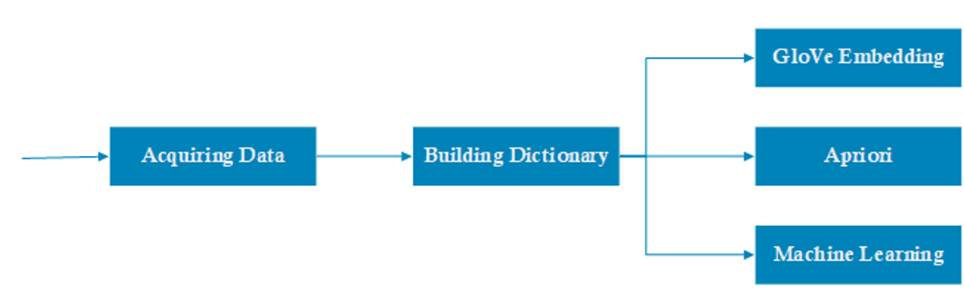
Methodologoy

Slide 10
Step1: Acquiring Data
Dataset:
Medical forums (MedHelp and AskAPatient) for Hypertension Diseases were used to acquire the dataset.
Pattern matching was used to find Age, Gender, weight, height and blood pressure.
All of these were acquired either as part of the crawling process. But are mostly acquired using moving window parsing and pattern matching.
A Jsoup crawler was implemented to retrieve data from medical forums.

Slide 11
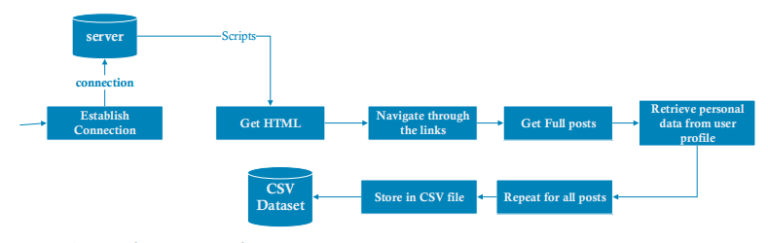
Acquiring Data: implemented crawler

Slide 12
Step2: Build Dictionary
Unified Medical Language System (UMLS):
A massive database covering a multitude of medical concepts.
UMLS was used to help identify ADRs, diseases and mental issues.
The mentions could be used as classes of ADRs which the supervised learning predicts, or it could be used as medical history features.
MetaMap was used to access the UMLS.

Slide 13
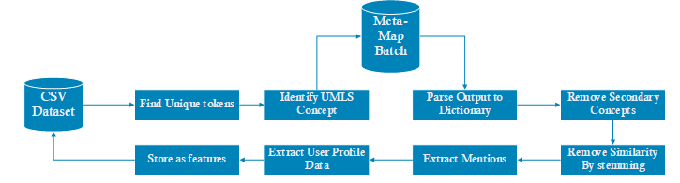
Step2: Build Dictionary

Slide 14
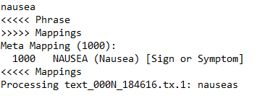

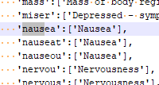


Slide 15
Step3: GloVe Embedding
Word Embedding :
Unsupervised NLP technique for learning frequency of terms in certain context.
Transfers words in a document into a continuous real number as a vector (similar to TFIDF and simple co-occurrence matrix)
Methods include Word2Vec and GloVe.
GloVe:
GloVe uses the co-occurrence ratios between two words and adding them as features for a neural network.
This reportedly gives an improved performance over Word2Vec.

Slide 16




Slide 17
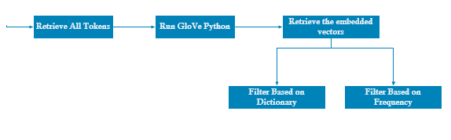
Step 3: Glove Embedding, Preprocessing

Slide 18
Step 3: Glove Embedding, Outcome
Dictionary Based Filtering :
Remove all the concepts except those revealed in the dictionary (ADRs and Drugs)
Revealed the most commonly occurring ADRs in relation to the drugs
Frequency Based Filtering :
Remove all the tokens with less than a cut-off frequency (20 and 40 were tried).
Revealed all most repeating concepts in relation to the drug or ADR.
AskAPatient is far more specialized with no personalized words.
Notes:
Stop here and open up tensorflow projector

Slide 19
Step 4: Association with Apriori
Association rule :
Identify the relationship between any concepts based on statistical analysis.
These statistics are based on two main metrics:
• Support: Records Containing A/Total Records = the number of times one or more items appear in the records.
• Confidence: Confidence (A =>B) = (Records containing both (A and B)) / (Records containing A) = the likelihood that if one item appear in a record, another one also appears.

Slide 20
Apriori Preprocessing
Minimums placed are as follows
Minimum support = 6%
Minimum confidence = 65%
The ADR and diseases mentions were added into lists of lists to be used in the Apyori library.

Slide 21
Step 4: Apriori Implementation
Apriori:
Apriori is a simplified algorithm for association rule, designed to reduce the computation time.
A minimum cut-off confidence and support are placed.
It first calculates support for 1-item set.
Then it removes all tokens that don’t reach the minimum.
Repeat for k-item sets, and remove relations that don’t reach the minimum confidence or support.

Slide 22
Step 4: Apriori Outcome
Outcome:
Apriori succeeded as a proof of concept, finding known ADRs in the drugs and giving obvious relationships for known diseases (like common cold and respiratory infection)
For AskAPatient dataset, the strangest relation obtained was that all diseases and ADRs occur more often with females than males.

Slide 23
Step 5: Supervised Learning
Classification Algorithms:
SVM
Random Forests (Classification and filtering)
Naïve Bayes
Dataset Pre-processing :
Missing Data: Solved by imputation
Data imbalance: Solved by applying SMOTENC
Data Subsets:
Not all data could be imputed, so the dataset was divided into three subsets:
complete dataset
Weights/heights subset
blood pressure subset
AskAPatient was added unaltered

Slide 24
Experiments
Experiments | Labels | Features
1 | Any ADR or Disease, and the number ADRs, mental issues and disease. | Age, gender, drug and drug family, and depending on the subset: Weights and Heights Blood Pressure
2 | Drugs and Drug Family | Features include labels from the Experiment 1 ADR/Disease mentions as medical history Features from Experiment 1
3 | Labels and Features from experiment 2 are mixed, with the wanted feature being removed from the comparison dynamically.

Slide 25
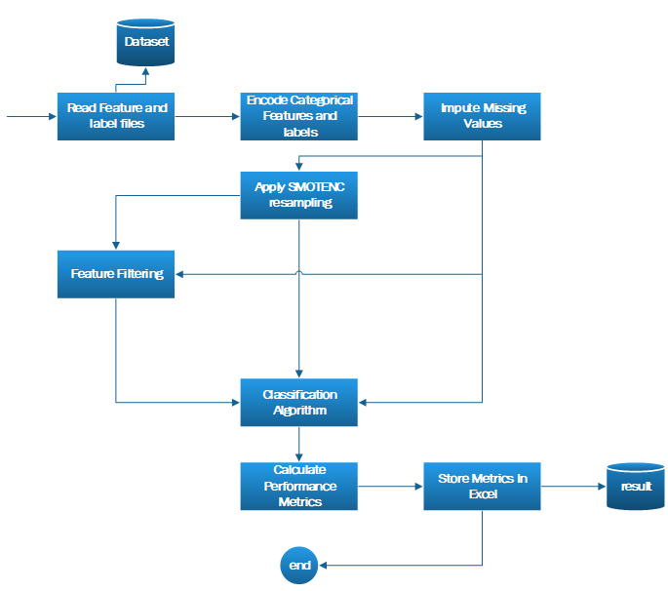

Slide 26
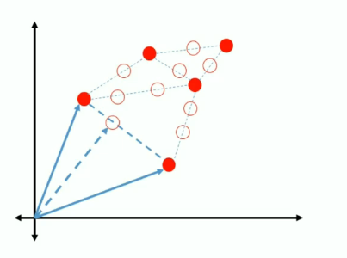
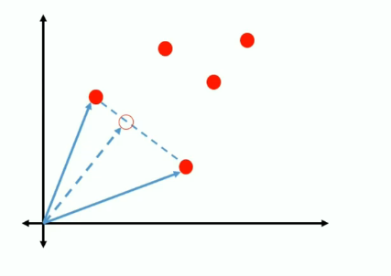
SMOTENC (Synthetic Minority Over-sampling Technique Nominal Continuous)

Slide 27
Random Forests
Classification:
Make multiple decision trees
Bootstrapping: Get random features, from them get random records.
Make a vote system based on the classification of all trees.
The highest voted classification is chosen.
Feature selection:
Purity metric can be measured
there is an assured de-correlation between all features
Purity of the tree can be used to derive the importance of the features
A minimum importance can be placed for the features (Default= Mean)

Slide 28
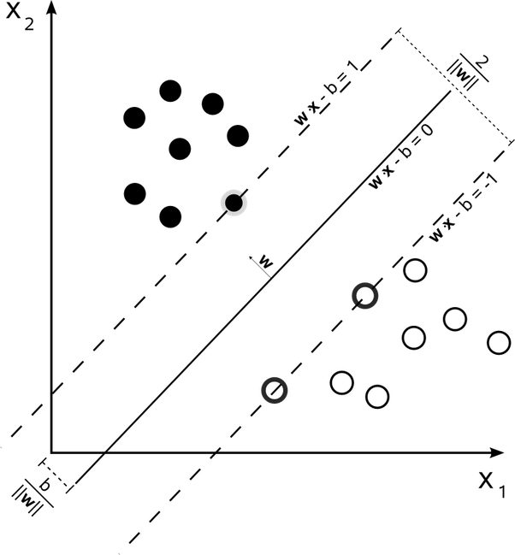
SVM

Slide 29

Naïve Bayes

Slide 30
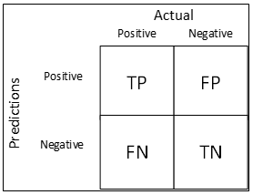
Evaluation Techniques
Accuracy = (TP+TN)/(FP+FN+TN+TP)
Precision = TP/(TP+FP)
Recall = TP/(TP+FN)
F1-Score= 2*Precision*Recall/(Precision + Recall)

Slide 31
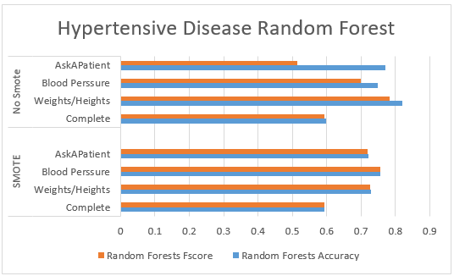
Step 5: Supervised Learning outcomes
SMOTENC vs No SMOTENC
Not using SMOTENC gives a great but misleading accuracy, best accuracy was weights/Heights.
Using SMOTENC improves the other metrics, and but decreases the accuracy
Already balanced datasets don’t show a massive change
Best without SMOTE | Acc: 0.82 Fscore: 0.78
Best with SMOTE | Acc:0.75 Fscore: 0.75

Slide 32
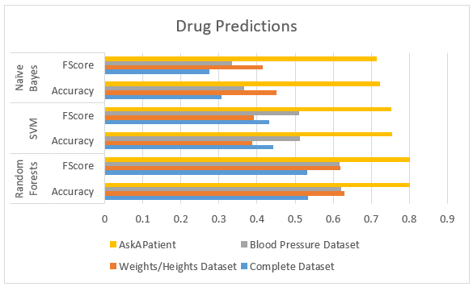
Step 5: Supervised Learning outcomes contd:
Comparison between Classifiers
Random forests was much better compared to the other classifiers.
From this moment on, only Random forests will be used.
This is the result from experiment 2. AskAPatient had the best result because it was the most consistent compared to the rest.
Also AskAPatient predicted only between two drugs

Slide 33
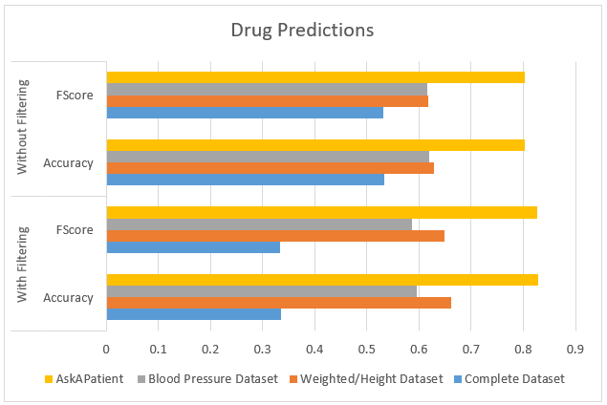
Step 5: Supervised Learning outcomes contd:
Filtering vs No Filtering with Random Forest.
Results vary between improved and deteriorated
Revealed the importance of some features, like the number of diseases the patient had.

Slide 34
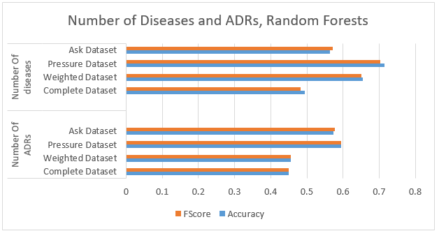
Step 5: Supervised Learning outcomes contd:
Predicting the number of ADRs and Diseases per user
Generally not a good idea because predicting ADRs depends on many other factors unavailable in this project
Number of diseases is easier to predict.
This could be an indication of healthiness.
Features | Meaning
0 | 0
1 | 1 to 3
2 | More than 3

Slide 35
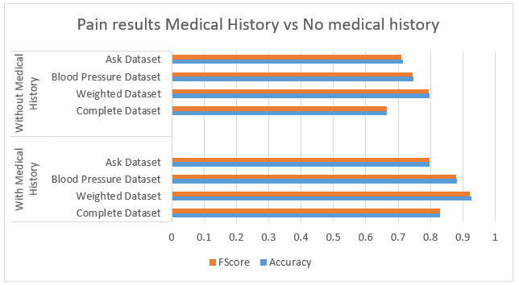
Step 5: Supervised Learning outcomes contd:
Predicting specific ADRs and Diseases
The results shown were improved after applying other discovered diseases and ADRs as medical history.
Quality of the datasets depends on the context, for this experiment, weights and Heights had the best results.
Best without History | Acc: 0.79 Fscore: 0.79
Best with History | Acc: 0.92 Fscore: 0.92

Slide 36
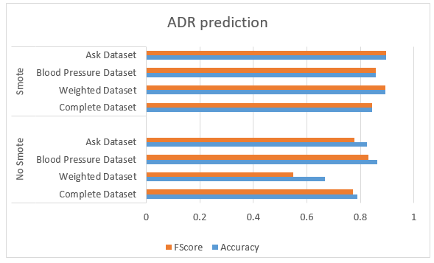
Step 5: Supervised Learning outcomes contd:
Predicting Presence of ADR
With Random forests
Made for comparison with related work
Generally comparable results even without SMOTENC
From Related Work 1 | Fscore: 0.848
From Related Work 2 | Fscore: 0.812
From Related Work 3 | Fscore: 0.821
Best of My Results | Fscore: 0.895

Slide 37
Conclusion
GloVe allowed me to find the most common ADR occurring with the any drug
Apriori showed that females are more susceptible to diseases and ADRs than males
Based on experiments 1 and 3 in supervised learning, using other mentions under the term medical history greatly improves the results
Experiment 2 showed that it is possible to predict which drug could be related to the medical history.
The prediction of the general presence of ADRs or the possibility of a specific ADR could be achieved.

Slide 38
Contribution
I wrote a crawler for medical forums.
Extracted user information and medical history to form a corpus and a dictionary in a method that could be replicated successfully using any dataset that contains this information.
I tested the usage of GloVe to find the relationship between drugs and ADRs in an unsupervised fashion.
Tested the usage of Apriori to deduce the relationship between ADRs, Drugs, diseases and gender of user.
Tested several classification techniques to find the most suited for ADR extraction.

Slide 39
Future Work
Collect a much bigger dataset on more drugs for more general diseases.
The idea could be further developed into a drug recommendation system for social media users, taking the user’s complaint and translating it into a well meaning prediction for the most suitable drug.
Data extraction could be improved to include more user related features.

Slide 40






Project Contribution
Java Jsoup crawler.
Python Libraries:
Pandas DataFrame (CSV file)
Scikit learn (Machine Learning)
GloVe (Word embedding for Pattern Mining)
Apyori
Imblearn (SMOTENC)
MetaMap
IDEs
Jupyter
Spyder
Anaconda

Slide 41
Thank you
Questions?

